Slide 1
American Craft Beer Analysis
2nd Nov, 2021 Jingqi Chang
Datasets from https://www.kaggle.com/nickhould/craft-cans
https://simplemaps.com/data/us-cities
Dashboard: https://public.tableau.com/app/profile/jingqi.chang/viz/CraftbeeranalysisintheUS

Slide 2
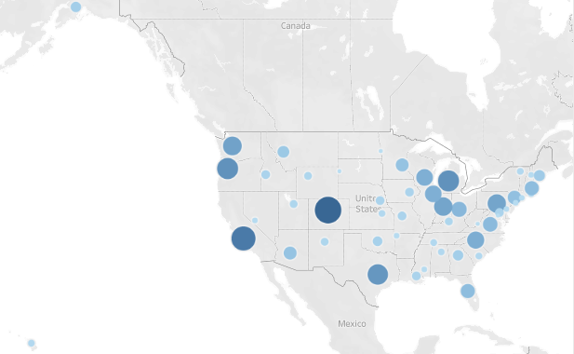
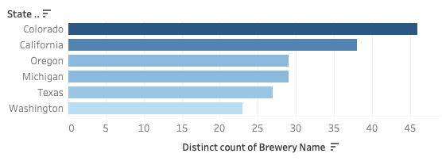
Breweries' distribution in the US states
The top 6 states with the most breweries in the US are Colorado (46 breweries), California, Oregon, Michigan, Texas and Washington. These States located in the middle, western and eastern of America.

Slide 3
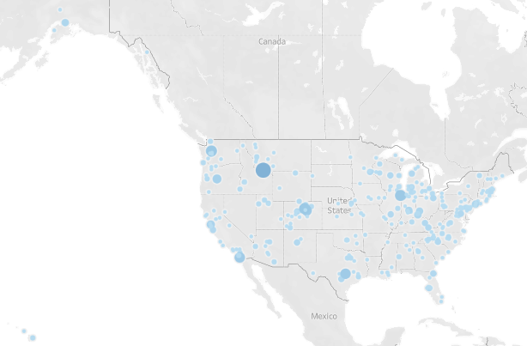
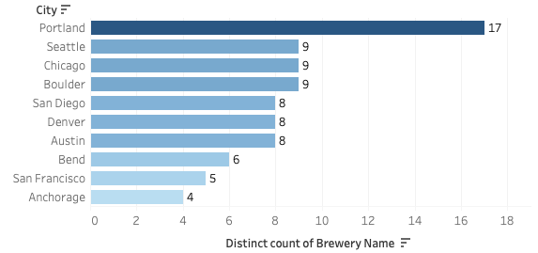
Breweries' distribution in cities
Portland has the most breweries (17) in the US and located in Oregon.

Slide 4
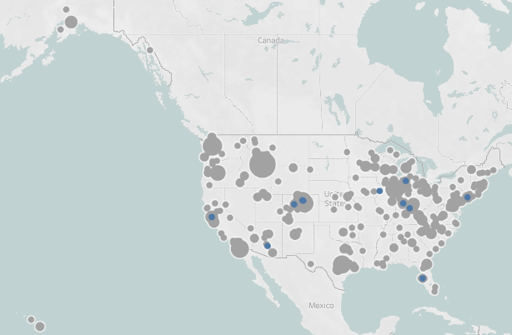
Location of top 10 Breweries
Top 10 craft beer breweries, which produce the most kinds of beers in the US are distributed across the country.

Slide 5
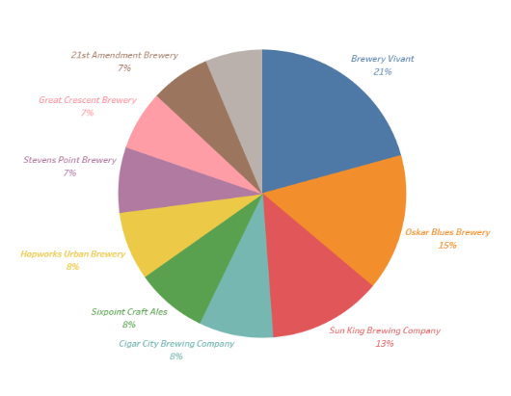
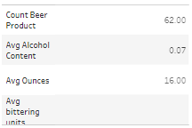
Top 10 Breweries
Top 10 breweries where produce the most categories of craft beers in the US. Craft beers from Brewery Vivant, Oskar Blues Brewery and Sun King Brewing Company together make up for near 50% of craft beers in top 10 breweries.
The detailed information from the biggest brewery. Brewery Vivant has 62 kinds of craft beer, the average alcohol content is 0.07 and all sizes of craft beer in this brewery is 16 ounces.

Slide 6
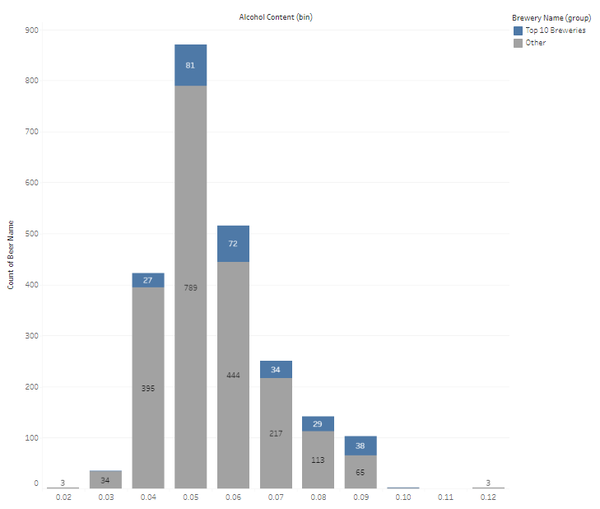
Alcoholic content of craft beer
The mode number of alcoholic content of craft beers in the US is 0.05. the most popular alcoholic content range is between 0.04 and 0.06.

Slide 7
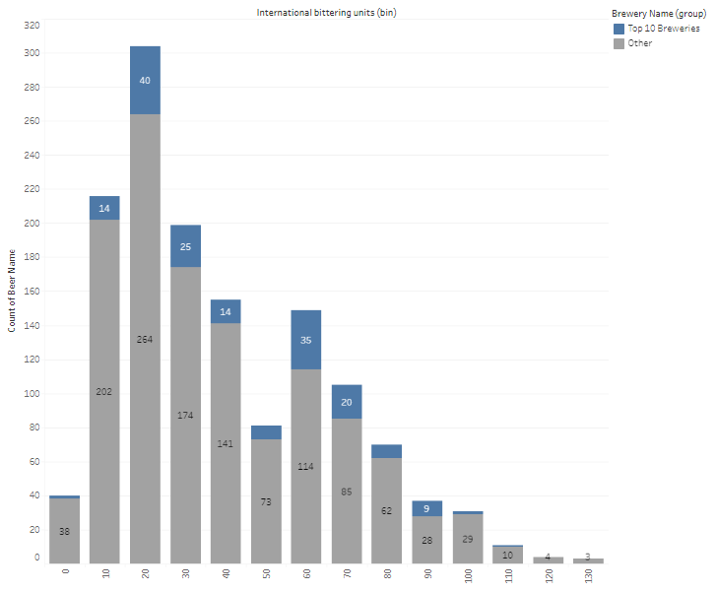
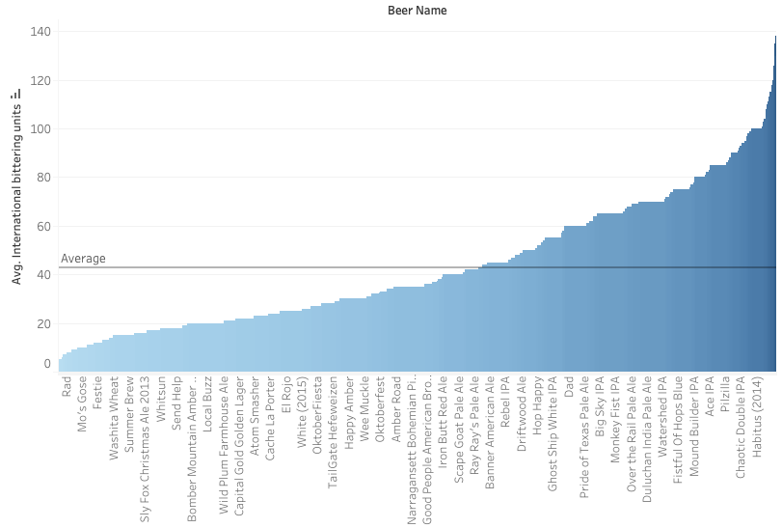
International bittering units of craft beer
The mode of craft beers' international bittering units (ibu) are around 20，the average ibu of all kinds of craft beer is 43, so the majority of craft beers' bittering units is lower than 43. But ibu in 60 is also popular in US beer marketing.

Slide 8
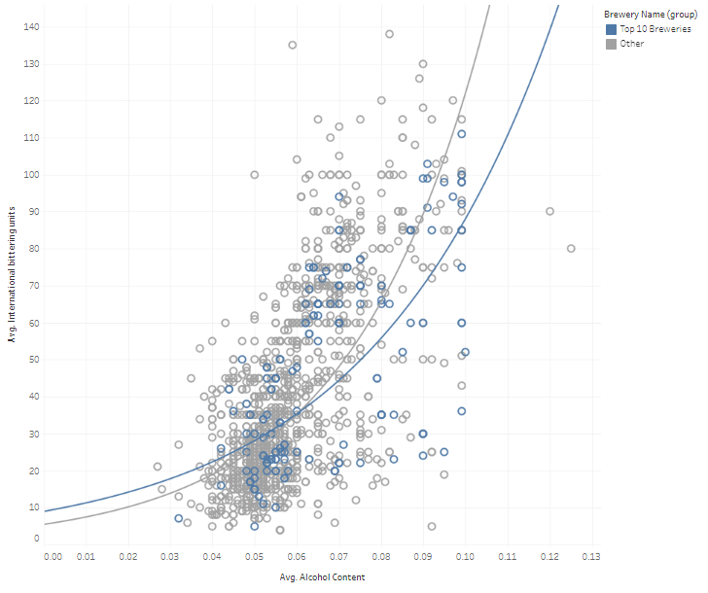
Relationship between alcoholic content and bittering units
There is an exponential relationship between craft beers' alcoholic content and bittering units. The higher the alcohol content, the more bitter the craft beer is.

Slide 9
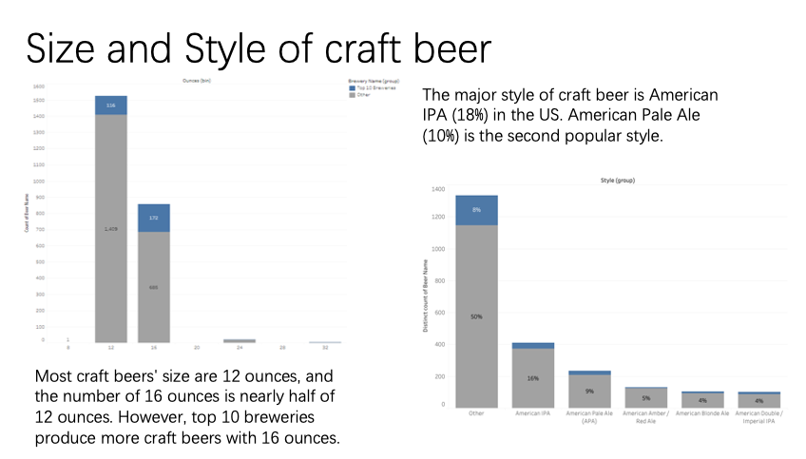

Slide 10
